Slide 1
Food Service App
Providing Affordable Healthy Food

Slide 2
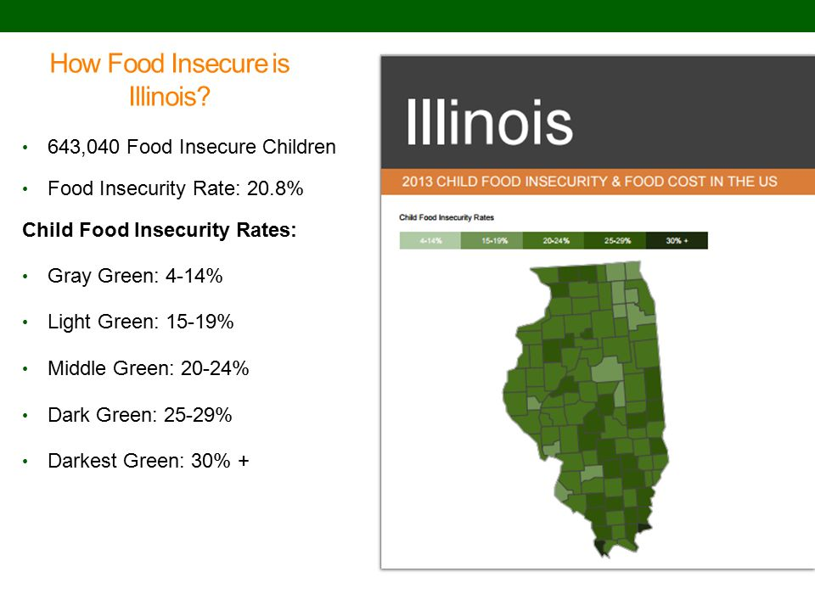
Food Insecurity
Low income individuals on food stamps allocated less than $1.50 per meal.
Roughly 83% of SNAP benefits go to households with a child, elderly person or disabled person.
25% of people who are food insecure are not eligible for benefits.
Notes:
Food stamps have not been adjusted for inflation for several years. Even as a supplement to a full time low paying jobs, putting food on the table every night can be a difficulty for many families.
http://www.justharvest.org/advocacy/the-truth-about-snap-food-stamps/

Slide 3
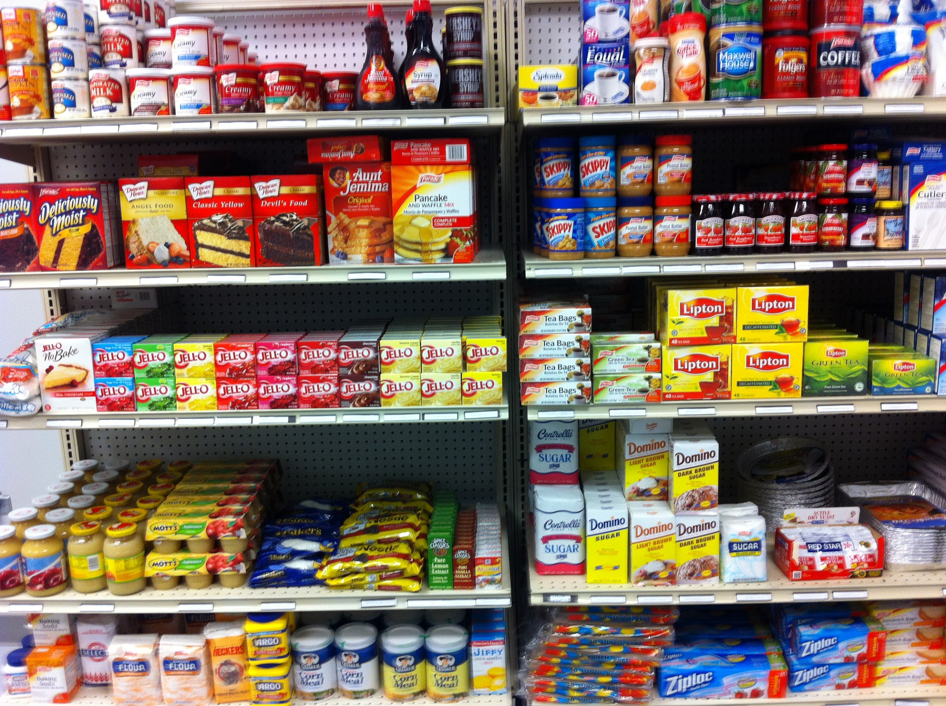
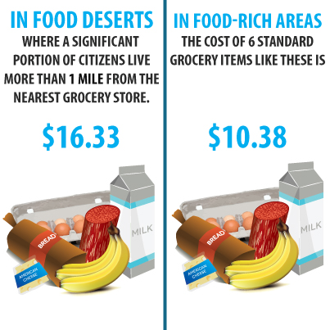
The Problem
Fresh fruits and vegetables are often more expensive than easy prepackaged meals loaded with sodium, preservatives and sugar.
Incentive programs to reward healthy choices exist, but more needs to be done in terms of availability and affordability.
This is especially true when considering food deserts.
Families often have to buy food at gas stations and convenience stores.
Notes:
The U.S. Department of Agriculture defines a food desert as an area with a poverty rate of at least 20 percent and where at least a third of the population lives more than a mile from a supermarket or large grocery store.
https://www.nytimes.com/2017/01/13/well/eat/food-stamp-snap-soda.html

Slide 4
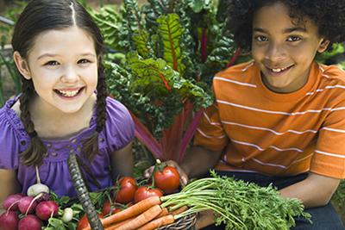
How this problem impacts everyone
Chicago’s childhood obesity ~ 2x national average.
Obesity and diet linked to health outcomes like diabetes, heart disease.
Also link to school performance, cognition and long term career readiness.
Achieving equal access to healthy foods is one of many ways of working towards equal opportunity and equal health outcomes.
Notes:
http://foodbusinessschool.org/faculty/sam-kass/
http://www.washingtonspeakers.com/speakers/biography.cfm?SpeakerID=8714
https://www.urban.org/sites/default/files/publication/31181/1001161-health-and-economic-mobility.pdf

Slide 5
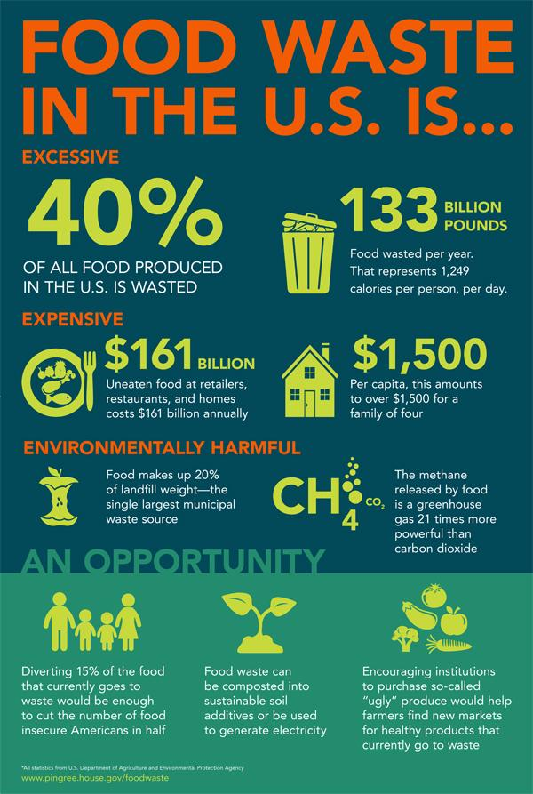
The Problem with Food Waste
In 2008, grocery stores threw away 43 billion pounds of produce.
Confusion between sell by and use by dates.
“Imperfect” or ugly produce often doesn’t make it onto the shelves.
Overstocked produce displays.
Consumer expectations.
Notes:
https://www.moveforhunger.org/grocery-stores-contribute-food-waste/

Slide 6
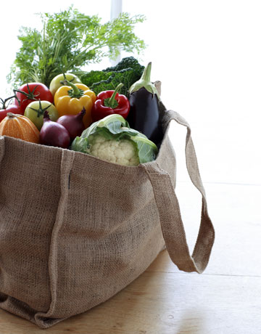
A Solution
Grocery stores register with the app to offer free and reduced produce and goods.
Consumers are notified about produce that is inexpensive or free.
Helps food insecure families who are close to grocery stores, but limited in funds.
Helps those in food deserts who have time but not enough money.
Helps food insecure families who don’t qualify for SNAP.
Notes:
While grocery trucks and community gardens make a huge difference for those in food deserts, this app can assist the subset of the population for whom time and distance are less of an issue than cost.

Slide 7
User Actions
Users register by creating a new account - Either as a client or a business
Businesses can create a new package
Clients will be notified of available packages gradually using a queue, based off whether or not they have recently claimed a package
Clients can claim a package, reserving it for pickup.
When a client picks up a package, businesses will mark it as received and the package will no longer be available/claimed

Slide 8
System
Server Machine(s)
Mobile App
Java, Android
API Server
ASP.NET
HTTP JSON API Call
HTTP JSON API Call
MySQL Query
Web Interface
HTML
HTTP GET/POST Form
Web Server
ASP.NET
Database
MySQL

Slide 9
